Slide 1

Experimental Design (14 reasons your results may be meaningless)

Slide 2
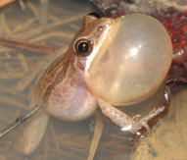
Question
Collect
Extract
Sequence
Estimate
Design
Enrich
Align
Employ
Bioinformatics
Overview:
Walk through typical experiment
Point out critical decisions
Use empirical example from frogs
Purpose: instill a healthy sense of skepticism

Slide 3
Question
Collect
Extract
Sequence
Estimate
Design
Enrich
Align
Employ
Observations → Questions → Experiments → Answers

Slide 4
Question
Collect
Extract
Sequence
Estimate
Design
Enrich
Align
Employ
Consider the following when posing a question:
What is already “known”?
Can the question be answered?
What types of data can be collected?
What types of analyses are available?
What assumptions do the analysis methods make?

Slide 5
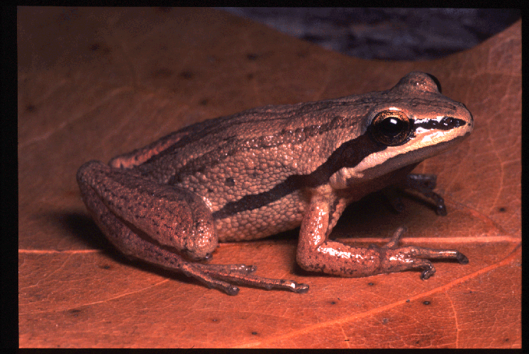
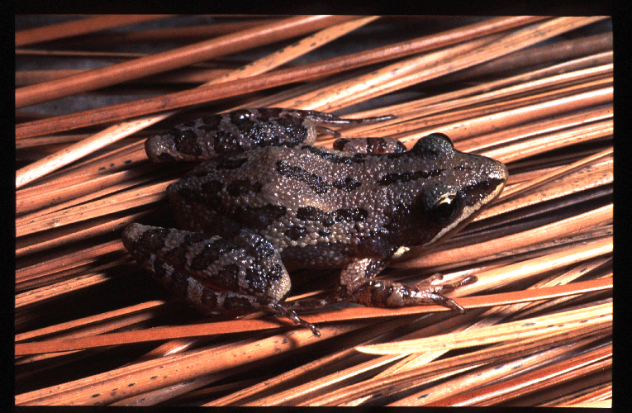
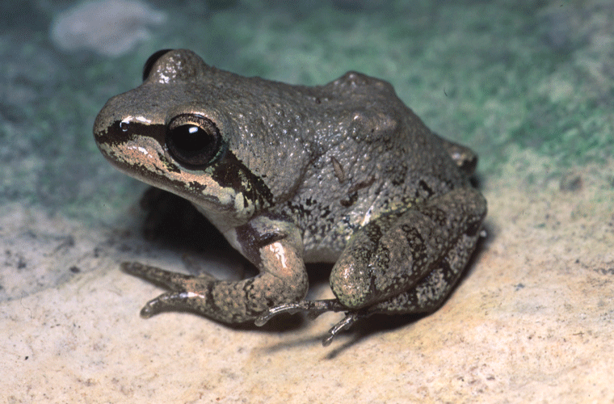
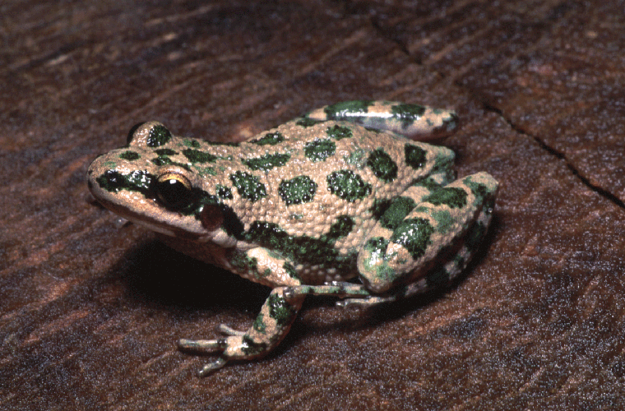
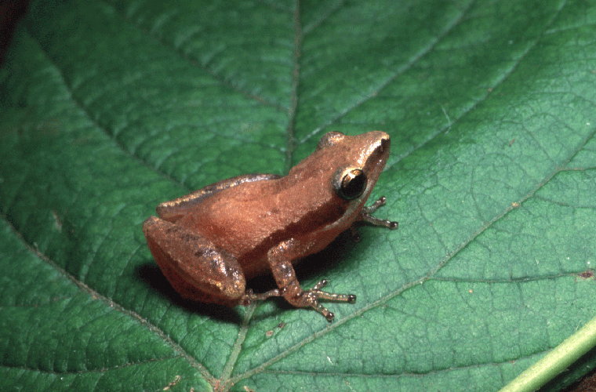
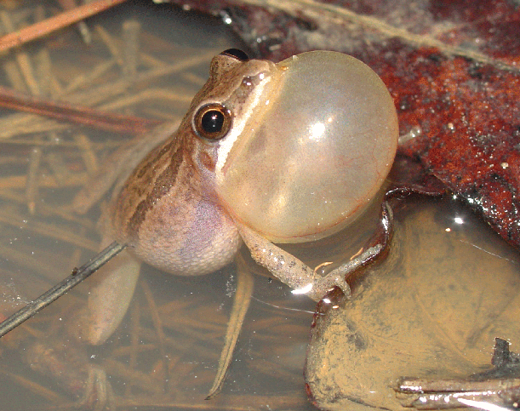
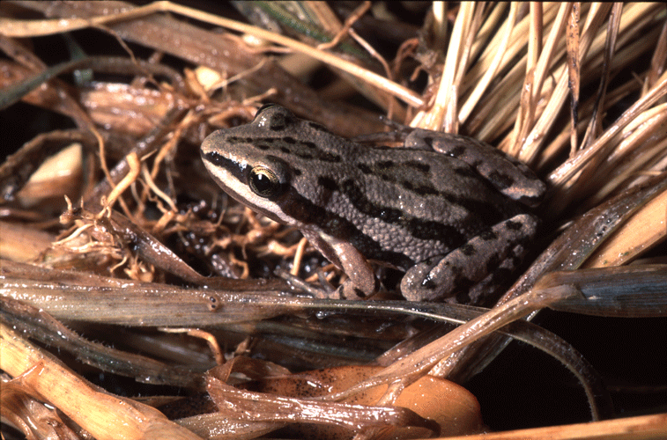
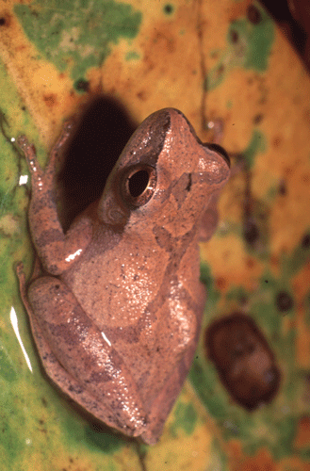
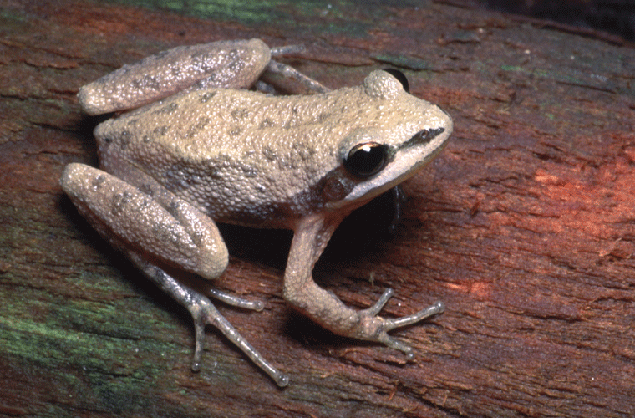
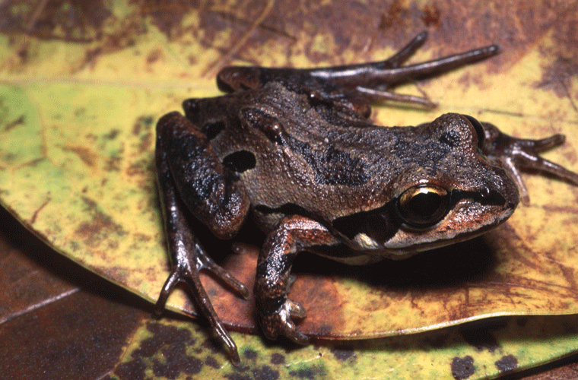
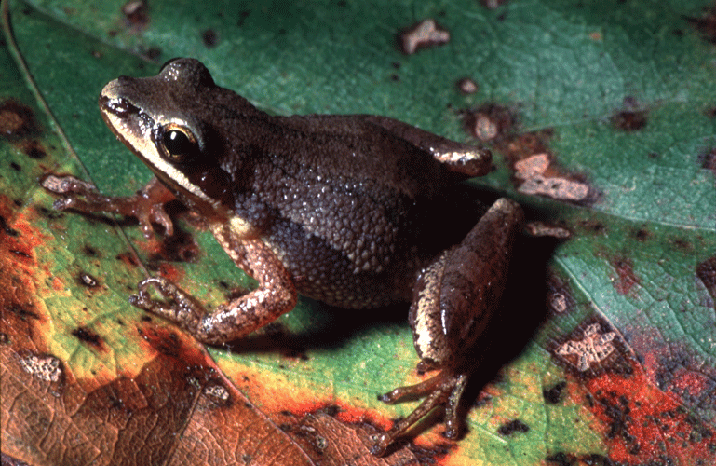
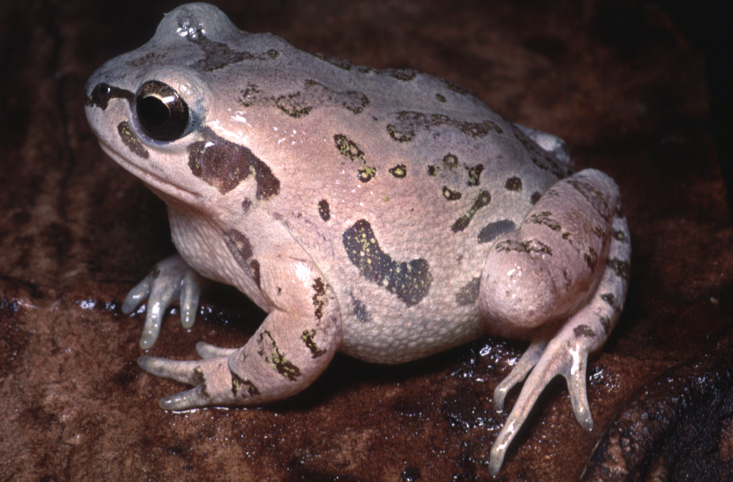
Question
Collect
Extract
Sequence
Estimate
Design
Enrich
Align
Employ
Aubrey Heupel

Slide 6
Question
Collect
Extract
Sequence
Estimate
Design
Enrich
Align
Employ
What processes drive diversity in chorus frogs?
How many species are there?
How are the chorus frogs related?
What are their geographic ranges?
Goals:
Reconstruct phylogeny of chorus frogs
Identify species boundaries
Apply the phylogeny to additional questions

Slide 7
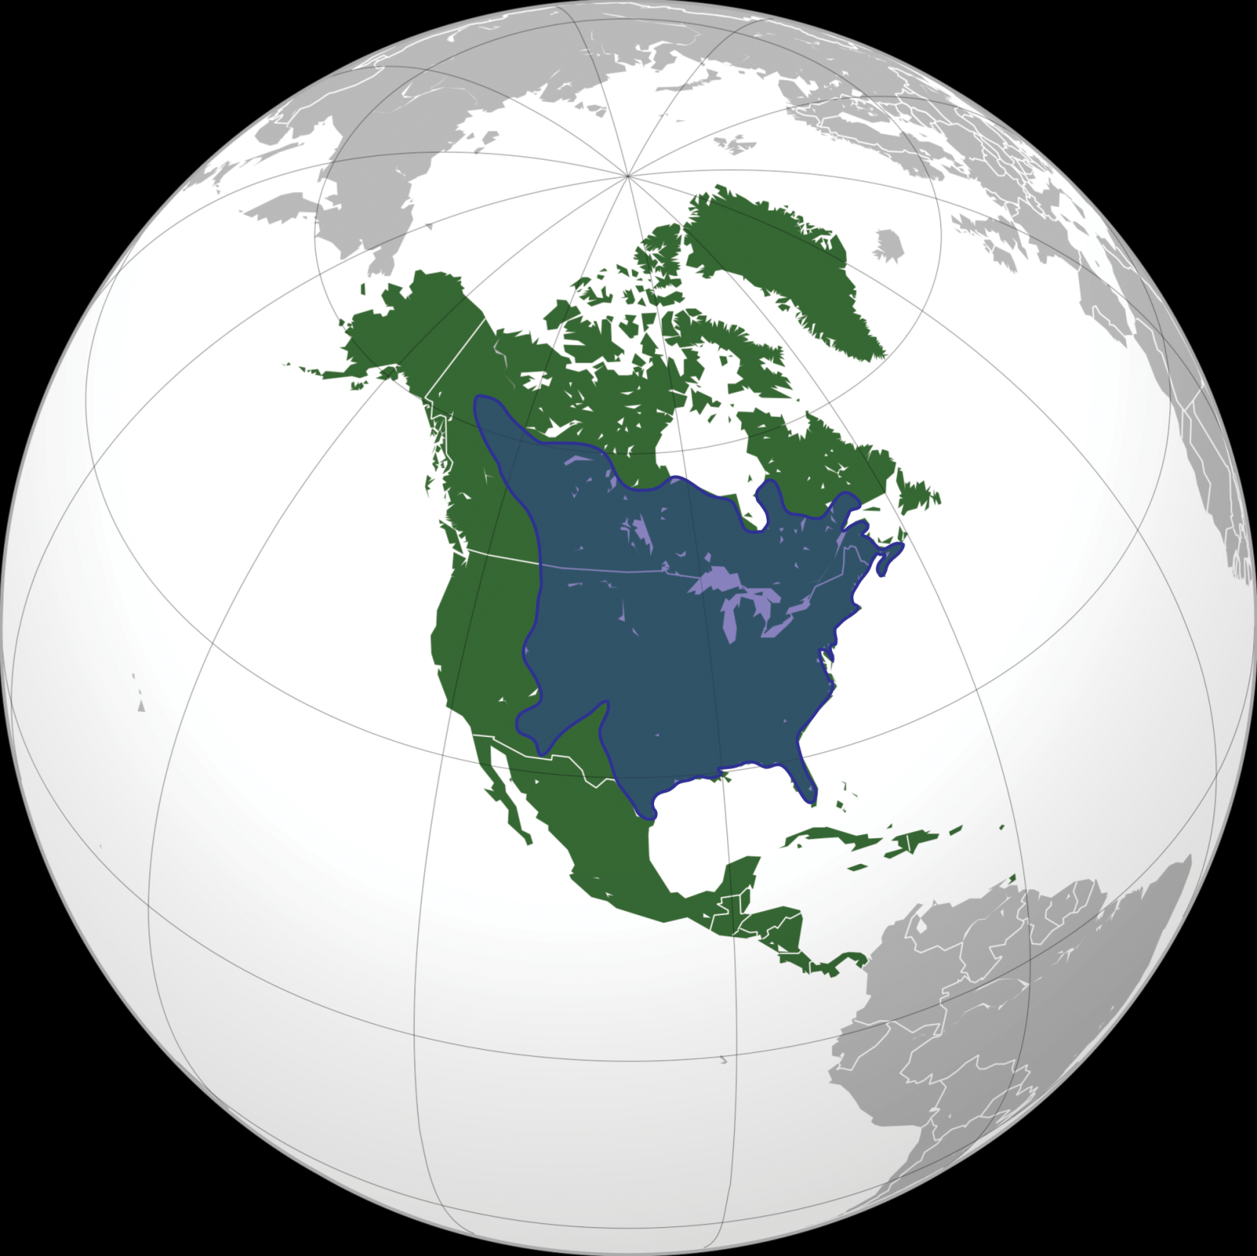
What should
be sampled?

Slide 8
Question
Collect
Extract
Sequence
Estimate
Design
Enrich
Align
Employ
Consider the following when designing an experiment:
How many samples are needed?
How should the samples be distributed?
How can bias be minimized?
What types of analyses are available?
What assumptions do the analysis methods make?
How will error propagate?
Theory &
simulations
should provide
answers

Slide 9

Question
Collect
Extract
Sequence
Estimate
Design
Enrich
Align
Employ
How many samples are needed?

Slide 10
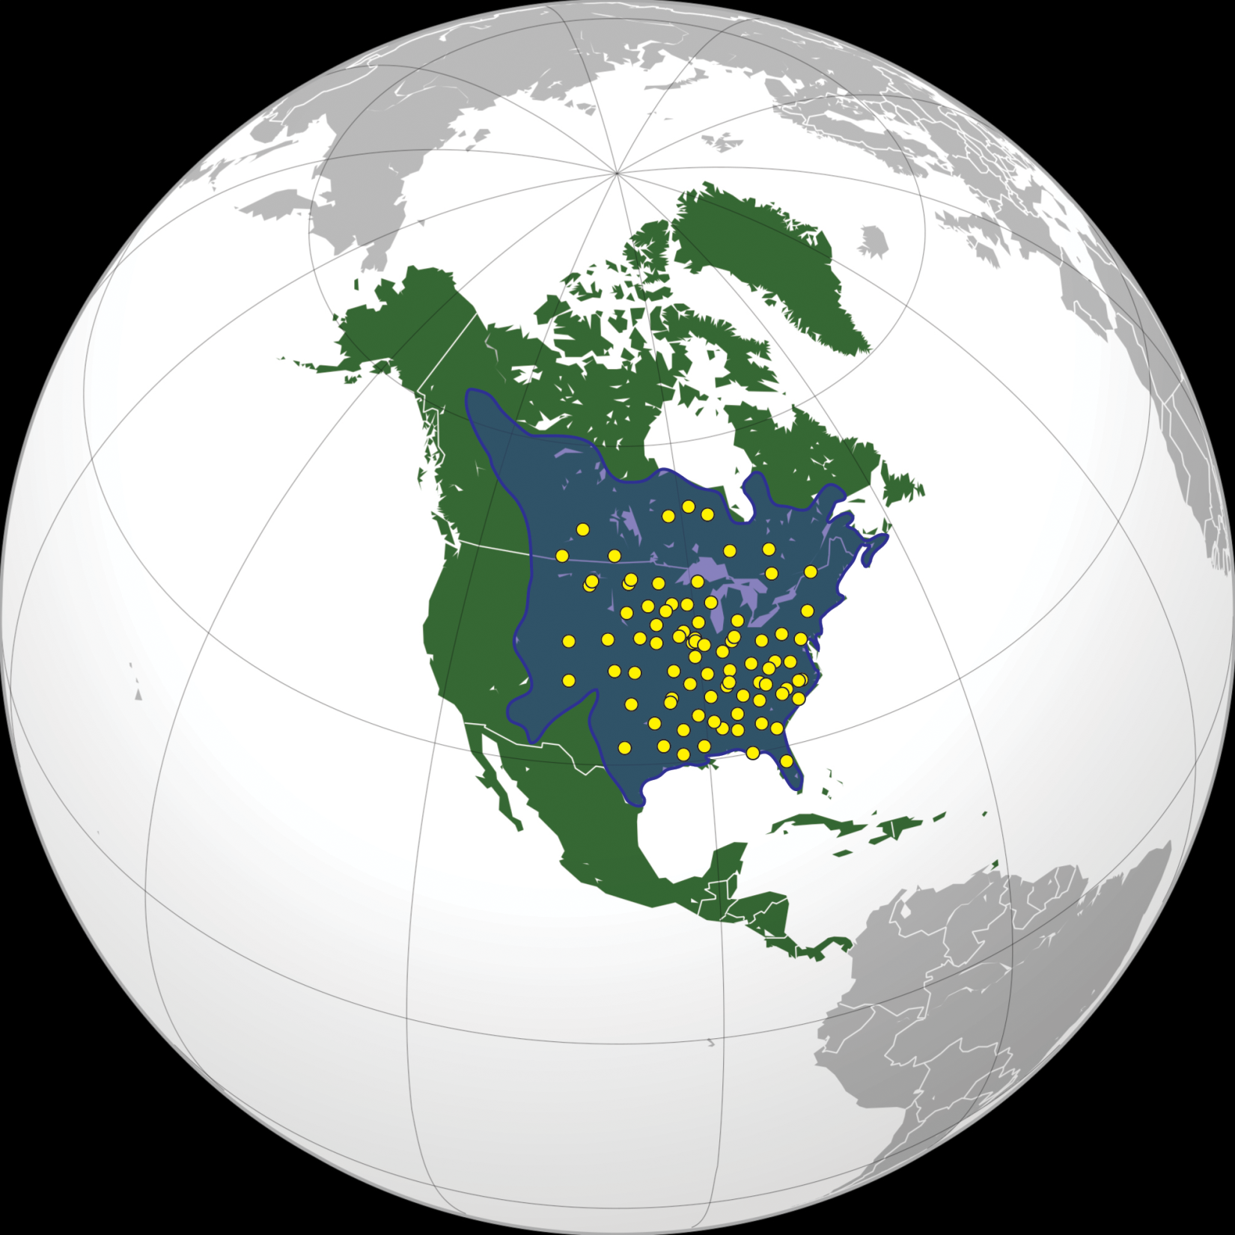
Samples should capture
geographic + genetic diversity

Slide 11
Question
Collect
Extract
Sequence
Estimate
Design
Enrich
Align
Employ
Data collection:
~100 samples collected in field
~100 samples collected by others*
~50 samples from museum collections*
~250 samples total

Slide 12
Question
Collect
Extract
Sequence
Estimate
Design
Enrich
Align
Employ
Extraction
Frog is euthanized
Liver is dissected out of frog*
DNA is extracted out of liver

Slide 13
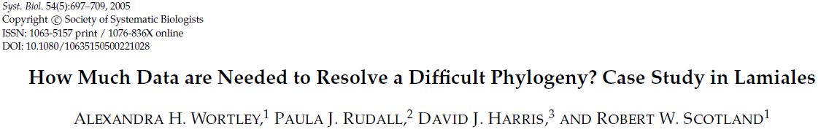
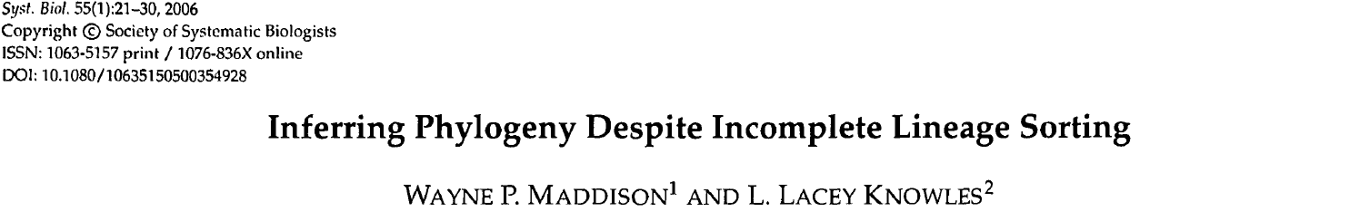
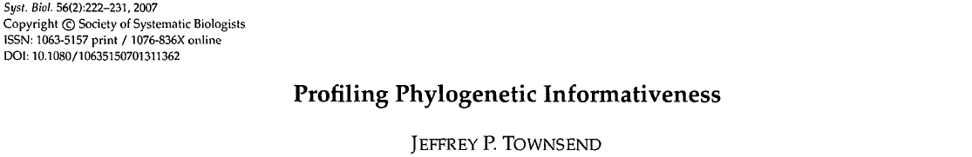
Question
Collect
Extract
Sequence
Estimate
Design
Enrich
Align
Employ
DNA enriched by PCR
Genes are chosen for sequencing
How many genes are needed?
What is useful?
What is available?

Slide 14
Question
Collect
Extract
Sequence
Estimate
Design
Enrich
Align
Employ
3 genes were sequenced (what was available)
12S
16S
tRNAval
~2400nt total

Slide 15
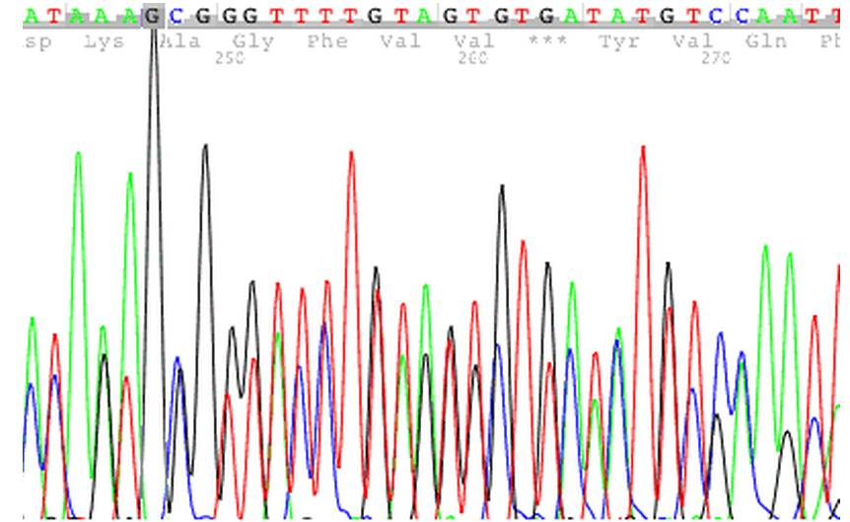
Question
Collect
Extract
Sequence
Estimate
Design
Enrich
Align
Employ
Which sequencing method should be used?
Sanger sequencing: watch out for heterozygotes!

Slide 16
Question
Collect
Extract
Sequence
Estimate
Design
Enrich
Align
Employ
Which sequencing method should be used?
Sanger sequencing: watch out for heterozygotes!
Ion Torrent sequencing: watch out for homopolymers!
ATA CCA TTT TCA TCC AGC ACC AGG ATC…
IPFSSSTR…
ATA CCA TTT TTC ATC CAG CAC CAG GAT C…
IPFFIQHQD…

Slide 17



Question
Collect
Extract
Sequence
Estimate
Design
Enrich
Align
Employ
Which sequencing method should be used?
Sanger sequencing: watch out for heterozygotes!
Ion Torrent sequencing: watch out for homopolymers!
Illlumina: watch out for short read assembly!
?

Slide 18
Question
Collect
Extract
Sequence
Estimate
Design
Enrich
Align
Employ
Sanger sequencing
All genes were mitochondrial (haploid)
Next-generation sequencing did not exist

Slide 19
Question
Collect
Extract
Sequence
Estimate
Design
Enrich
Align
Employ
Which alignment method should be used?
Completely automated?*
Completely manual?
Automated alignment then manual adjustment?

Slide 20
Question
Collect
Extract
Sequence
Estimate
Design
Enrich
Align
Employ
Automated alignment then manual adjustment

Slide 21
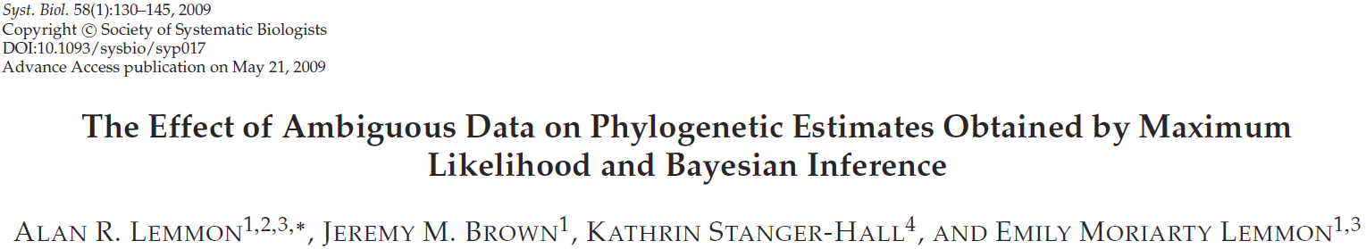
Question
Collect
Extract
Sequence
Estimate
Design
Enrich
Align
Employ
Should the entire alignment be used?
Individual 1 -ACTCATACTAGAAGGTCTAGATCTAGAT
Individual 2 -----ATACTAGAAGGTCTAGATCTAGAT
Individual 3 --CTCATGCTAGAA---CTAGATCTAGAT
Individual 4 ---TCATGCTAGAA---CTAGATCTAGAT

Slide 22
Question
Collect
Extract
Sequence
Estimate
Design
Enrich
Align
Employ
Ends were trimmed
Ambiguous sites were removed
-ACTCATACTAGAAGGTCTAGATCTAGAT
-----ATACTAGAAGGTCTAGATCTAGAT
--CTCATGCTAGAA---CTAGATCTAGAT
---TCATGCTAGAA---CTAGATCTAGAT
ATACTAGAAGGTCTAGATCTAGAT
ATACTAGAAGGTCTAGATCTAGAT
ATGCTAGAA---CTAGATCTAGAT
ATGCTAGAA---CTAGATCTAGAT
ATACTAGAAGGTCTAGATCTAGAT
ATACTAGAAGGTCTAGATCTAGAT
ATGCTAGAA---CTAGATCTAGAT
ATGCTAGAA---CTAGATCTAGAT
ATACTAGAACTAGATCTAGAT
ATACTAGAACTAGATCTAGAT
ATGCTAGAACTAGATCTAGAT
ATGCTAGAACTAGATCTAGAT

Slide 23
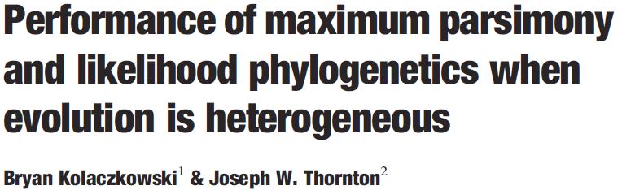
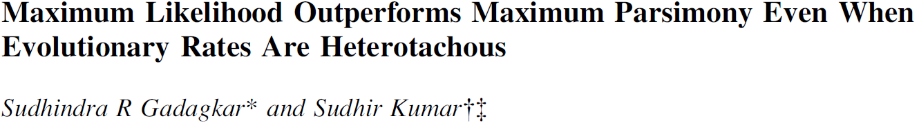

Question
Collect
Extract
Sequence
Estimate
Design
Enrich
Align
Employ
What method of optimization should be used?
Maximum parsimony
Maximum likelihood
Bayesian

Slide 24
Question
Collect
Extract
Sequence
Estimate
Design
Enrich
Align
Employ
Maximum likelihood
Bayesian

Slide 25
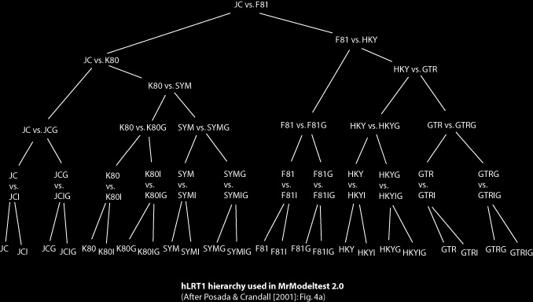
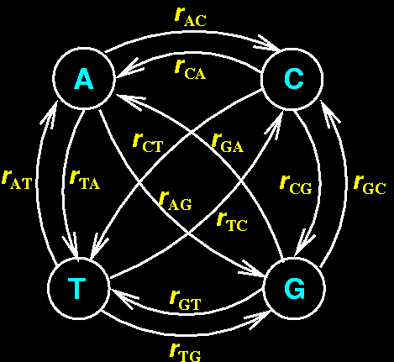
Question
Collect
Extract
Sequence
Estimate
Design
Enrich
Align
Employ
What model of sequence evolution should be assumed?

Slide 26
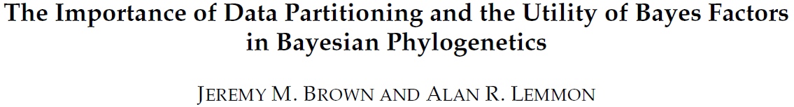
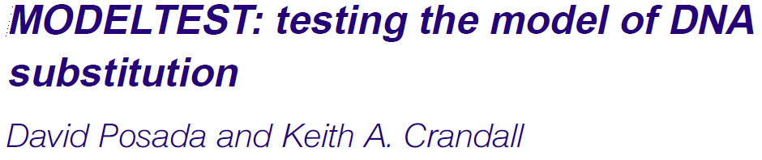
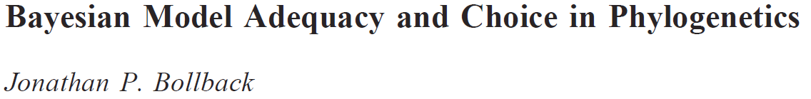
Question
Collect
Extract
Sequence
Estimate
Design
Enrich
Align
Employ
What model of sequence evolution should be assumed?

Slide 27
Question
Collect
Extract
Sequence
Estimate
Design
Enrich
Align
Employ
ModelTest was used to choose “best” model

Slide 28
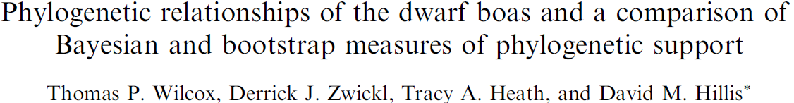
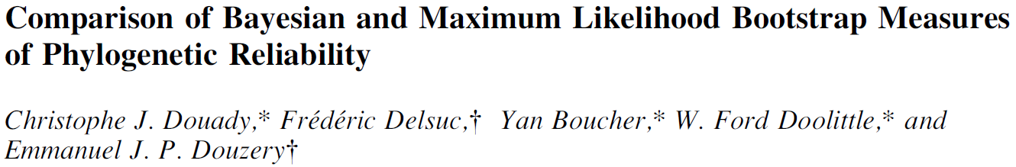
Question
Collect
Extract
Sequence
Estimate
Design
Enrich
Align
Employ
How should we measure uncertainty?
Bootstrap support
Bayesian posterior probability

Slide 29
Question
Collect
Extract
Sequence
Estimate
Design
Enrich
Align
Employ
Both measures were used
Bootstrap support
Bayesian posterior probability

Slide 30
Drum roll please…

Slide 31
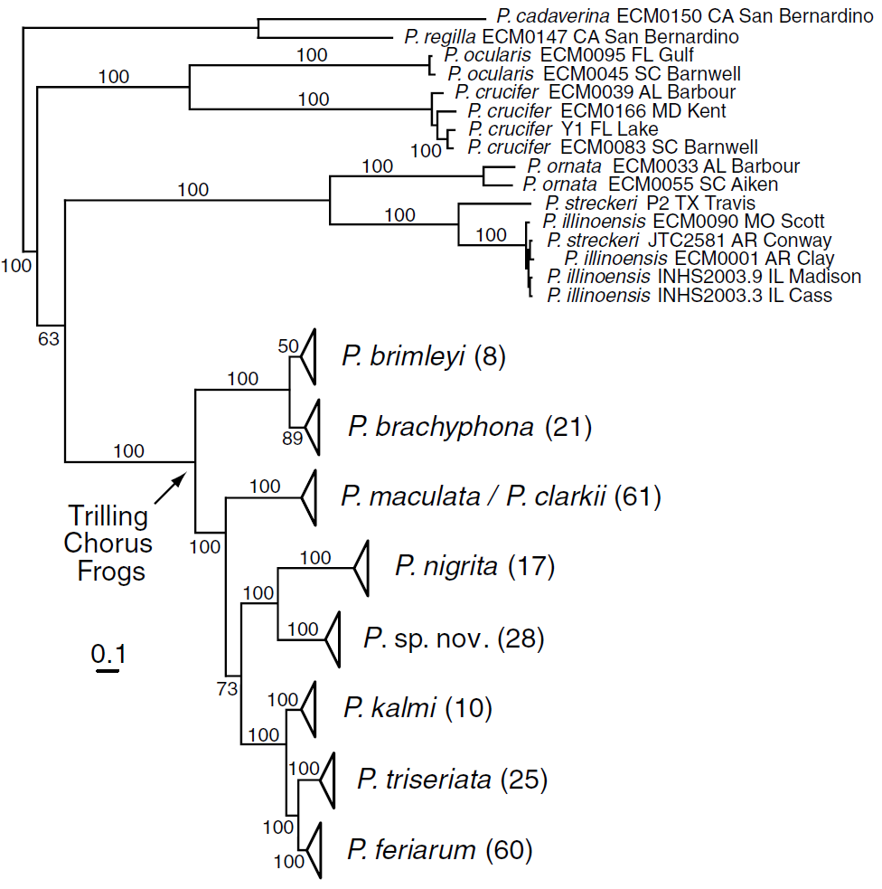
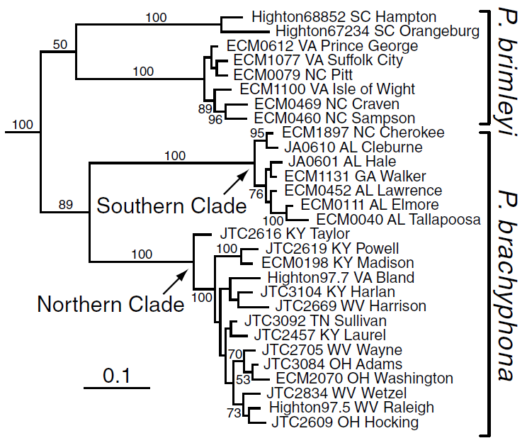

Slide 32
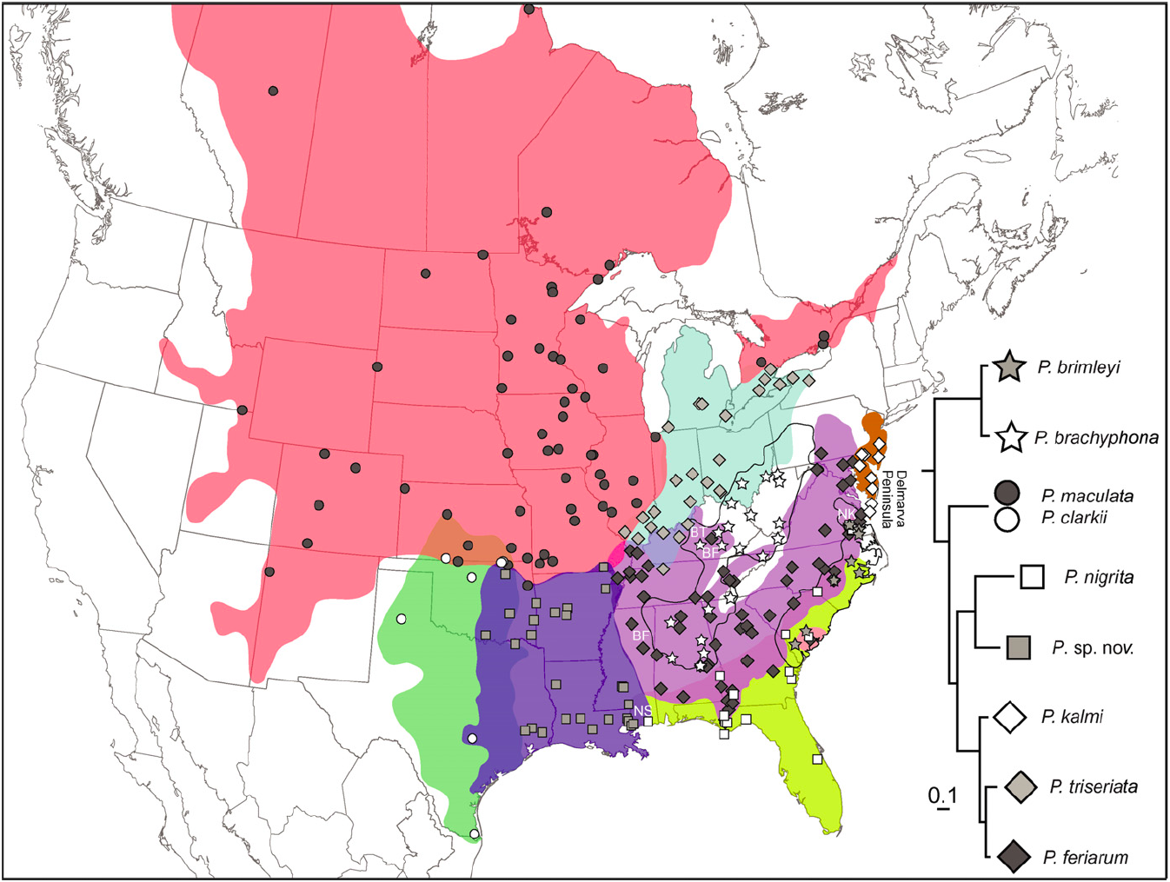

Slide 33
Question
Collect
Extract
Sequence
Estimate
Design
Enrich
Align
Employ
When applying your findings
Cross-check and validate when possible
Account for uncertainty in previous steps**
Beware of assumptions, test for robustness

Slide 34
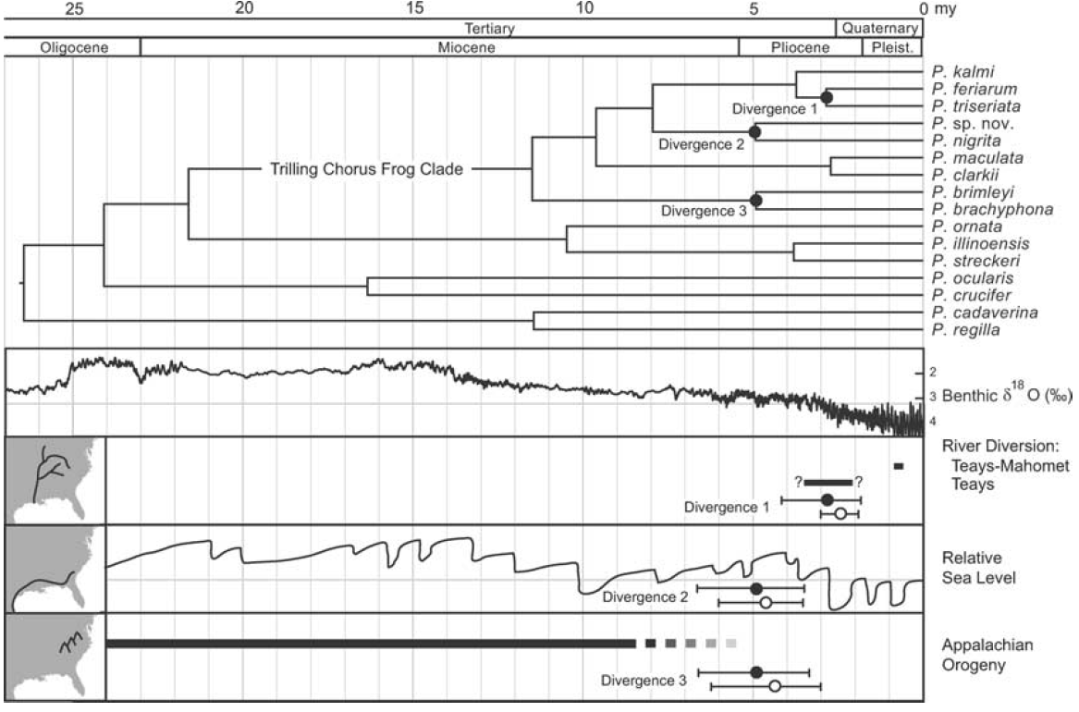
Question
Collect
Extract
Sequence
Estimate
Design
Enrich
Align
Employ
Applications of Pseudacris phylogeny:
Divergence times estimated
Correlated with some geological events
New species described
Validated with morphological and acoustic analyses
Phylogeographic history estimated

Slide 35
Question
Collect
Extract
Sequence
Estimate
Design
Enrich
Align
Employ
Downstream
assumptions?
Job done.
Rest easy?
Measure of
uncertainty?
Method of
estimation?
Model of evolution?
Remove missing data?
Method of alignment?
Method of sequencing?
Method of enrichment?
Only frog DNA?
Rely on museums / others?
Types of genes?
Number of genes?
Locations of individuals?
Number of individuals?

Slide 36

Question
Collect
Extract
Sequence
Estimate
Design
Enrich
Align
Employ
Number of genes?

Slide 37
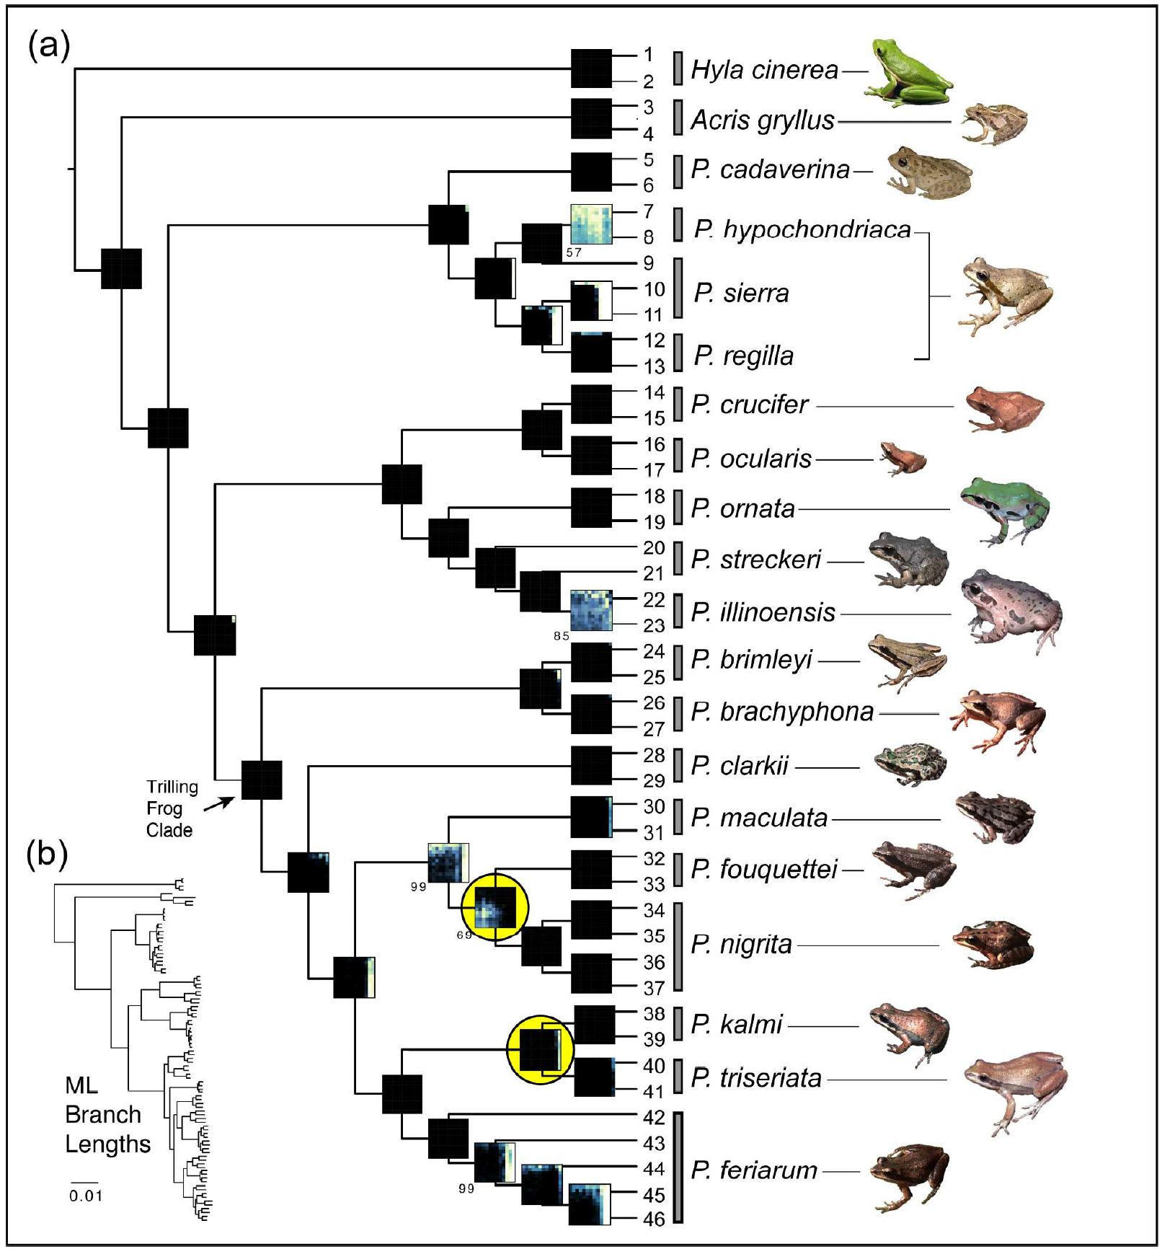

Slide 38
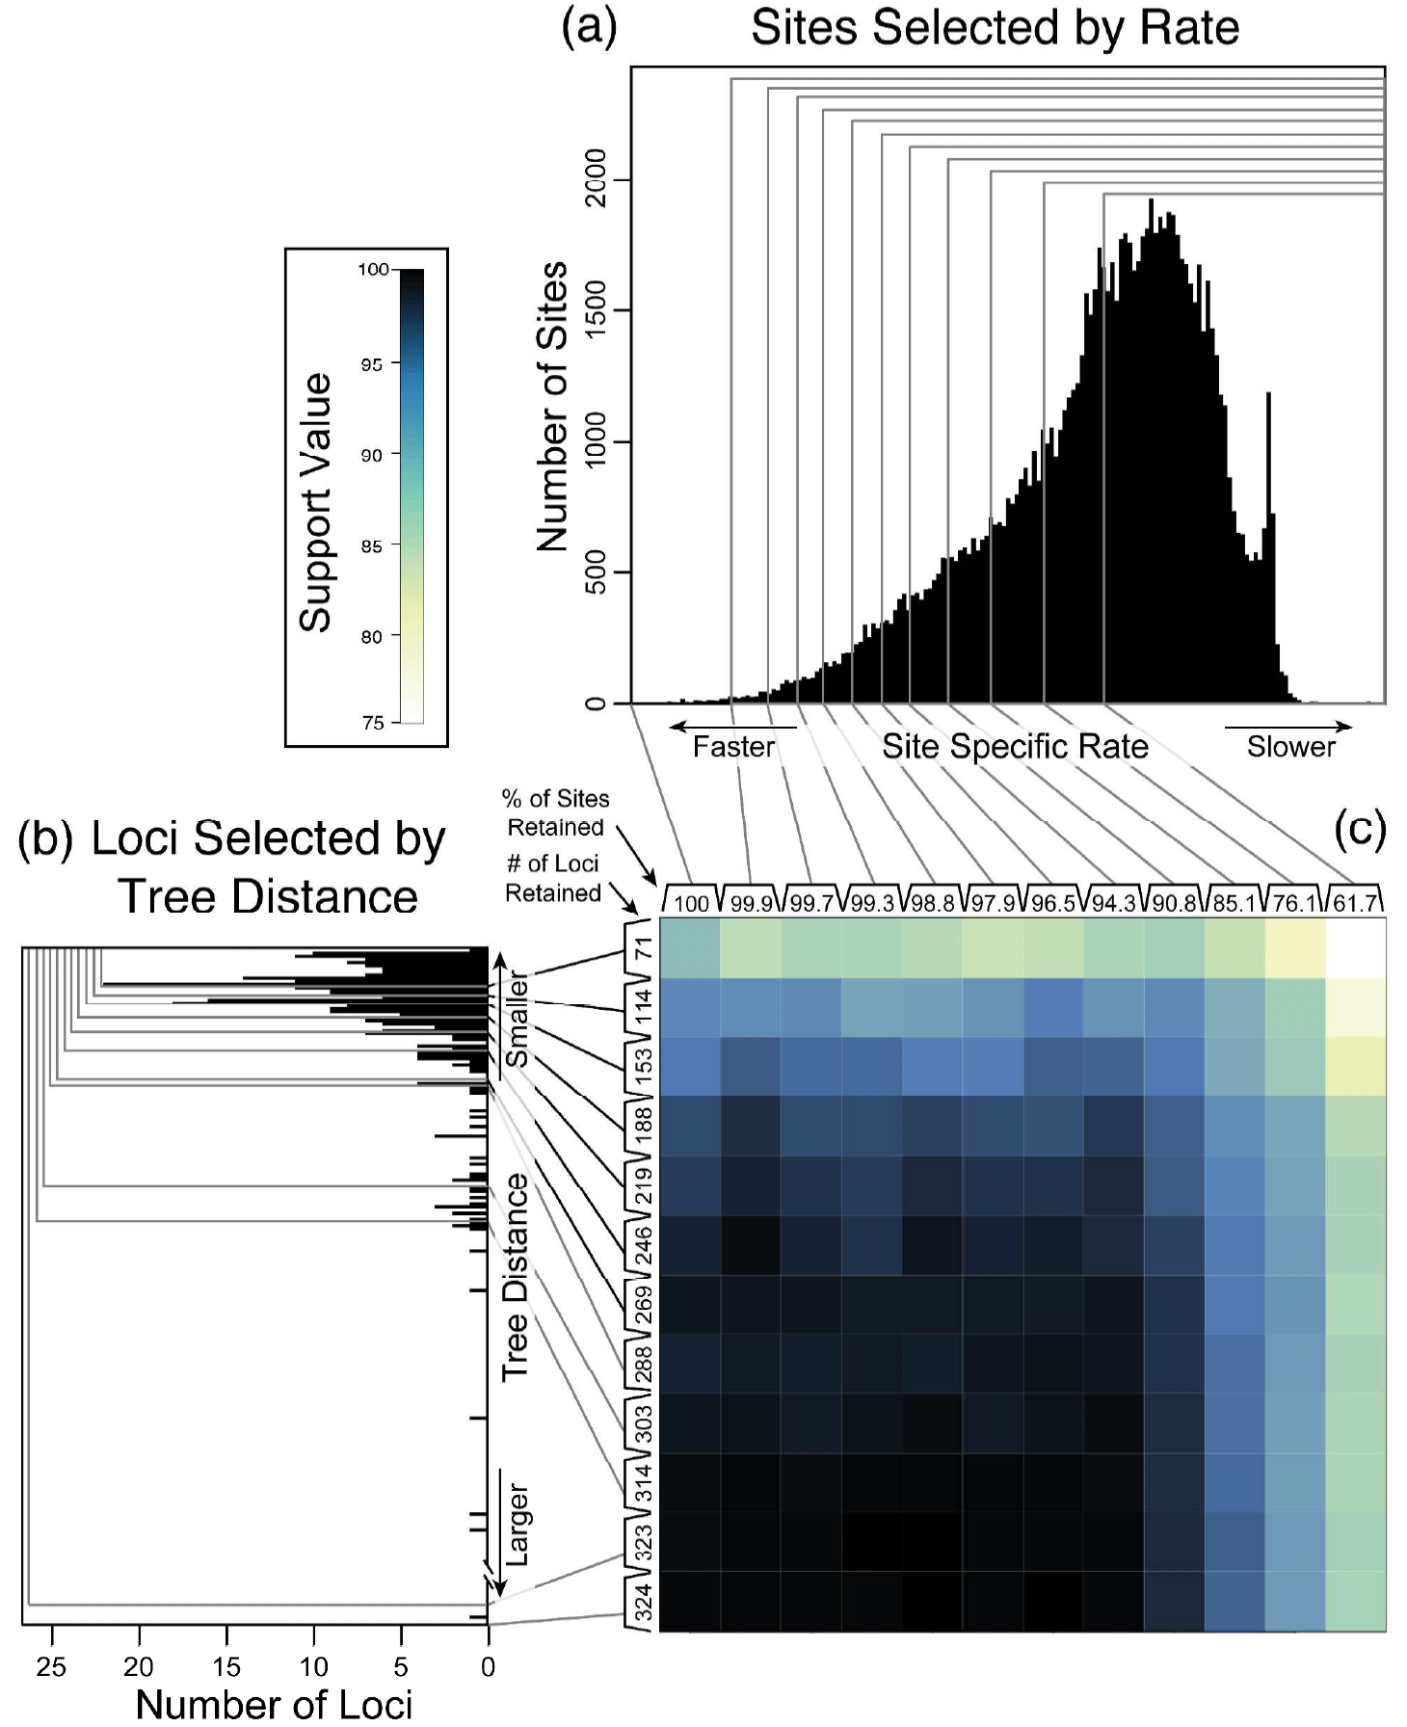

Slide 39
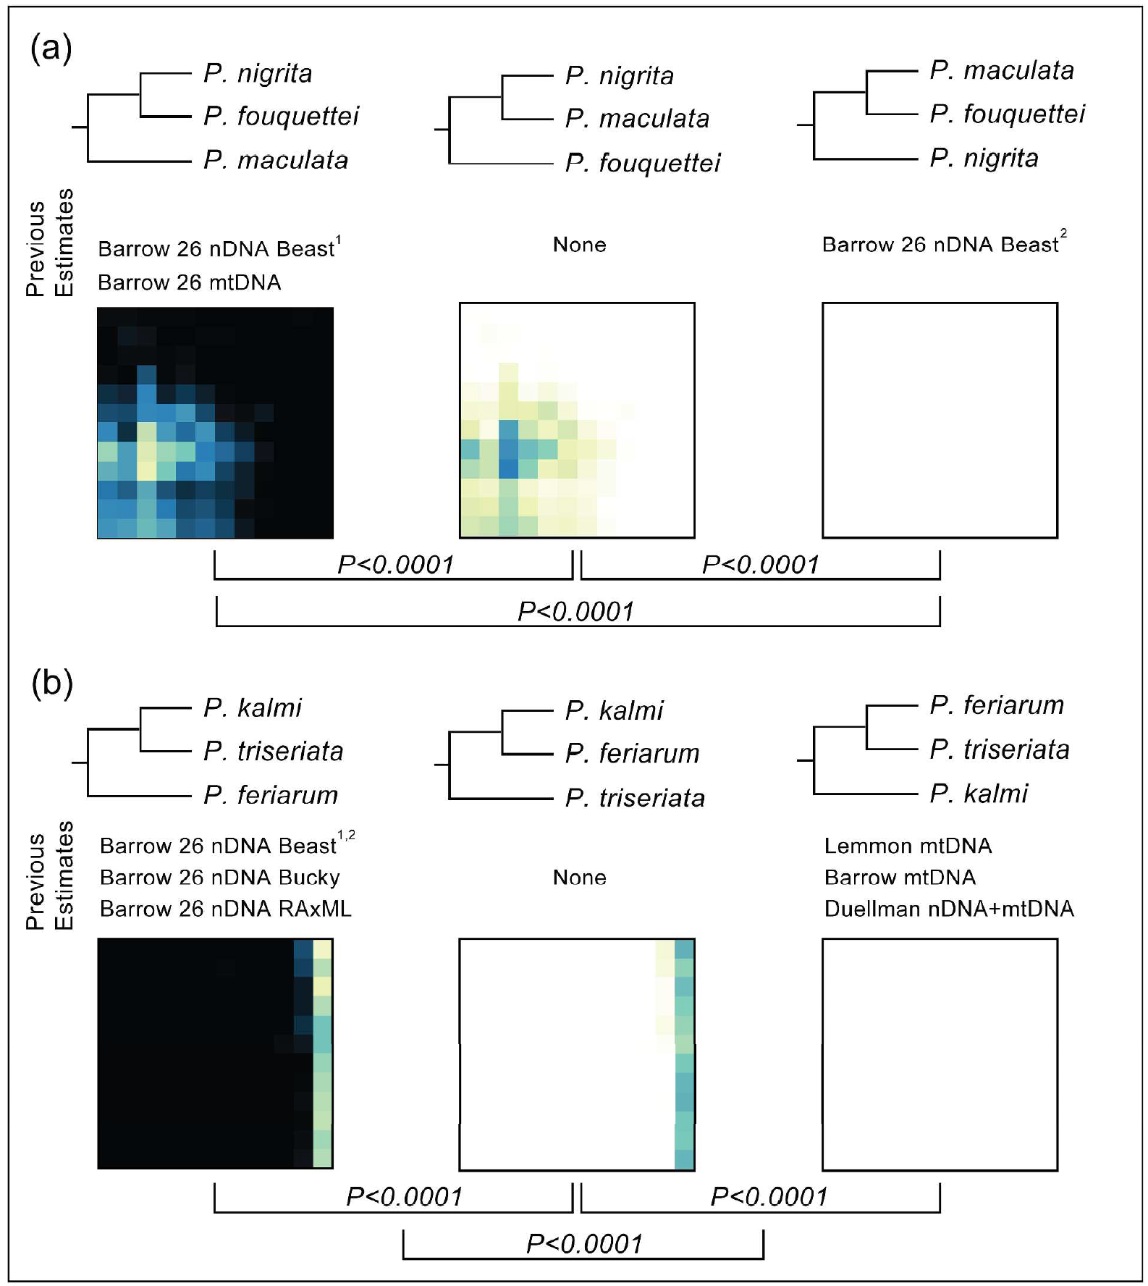

Slide 40
Question
Collect
Extract
Sequence
Estimate
Design
Enrich
Align
Employ
Downstream
assumptions?
Bioinformatics
Measure of
uncertainty?
Method of
estimation?
Model of evolution?
Remove missing data?
Method of alignment?
Method of sequencing?
Method of enrichment?
Only frog DNA?
Rely on museums / others?
Types of genes?
Number of genes?
Locations of individuals?
Number of individuals?

